Slide 1
Unit 3A
Human Diversity and Change
Inheritance
Polygenic and multi-allelic inheritance

Slide 2

Study Guide
Read:
Our Human Species (3rd edtn)
Chapter 10, section 16
Chapter 18, sections 6.7-6.8, 6.11
Complete:
Human Biological Science Workbook
Topic 16 – Modes of Inheritance

Slide 3
Polygenic inheritance
Polygenic traits are determined by more than one pair of genes.
Polygenic phenotypes exhibit continuous variation, since each different gene permutation results in just a small phenotypic change.
Many medical conditions such as autism, cancer and type 2 diabetes are polygenic.

Slide 4
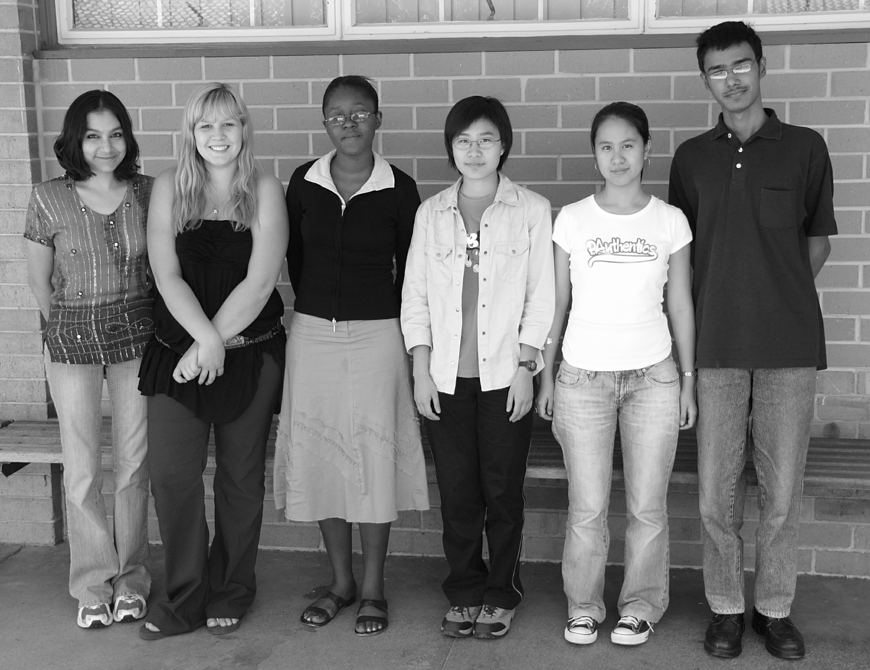
Polygenic phenotypes
Polygenic inheritance is responsible for many phenotypic traits. Examples include skin pigmentation, height, intelligence and stature.
(note that these traits all result from the interaction of the genes with environmental factors)

Slide 5
Skin Colour
Determination of skin colour is an example of polygenic inheritance.
Skin colour is determined by at least three pairs of genes (possibly many more).
For example, let the allelic forms of the three genes be: A/a, B/b, C/c
Phenotype (skin colour) | Genotype
Dark skin Intermediate skin Light skin | AA, BB, CC Aa, Bb, Cc aa,bb,cc

Slide 6
Multiple alleles
Some genes have more than two allelic forms. These different forms of a single gene are referred to as multiple alleles.
Multiple alleles can result in the blending of phenotypes.

Slide 7
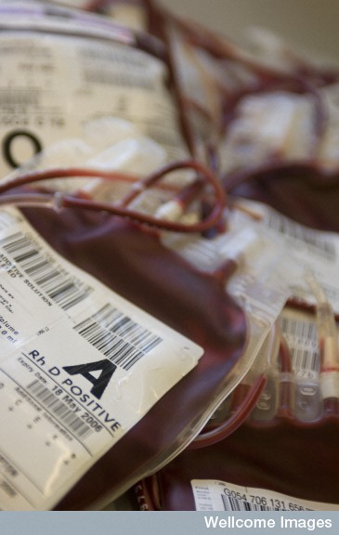
ABO blood group system

Slide 8
The ABO blood group system
The ABO blood group system is a way of classifying blood based on the presence or absence of two antigens on the red blood cells.
Three allelic forms of a single gene are responsible for the ABO system.
A person’s ABO blood group is determined by which two of the three possible alleles they inherit from their parents.

Slide 9
Possible phenotypes & genotypes
The three alleles of the gene are represented by the symbols IA, IB & iº
The IA & IB alleles are co-dominant – both are dominant to the iº allele
(IA = IB > iº)
Phenotypes | Genotypes
A | I^{A}I^{A}, I^{A}i^{O}
B | I^{B}I^{B}, I^{B}i^{O}
AB | I^{A}I^{B}
O | i^{O}i^{O}

Slide 10
Blood group A
Blood group B
Blood group AB
Blood group O
A
B
B
A
A
B
B
A
A
A
B
B
Blood group A – red blood cells carry A antigen
Blood group B – red blood cells carry B antigen
Blood group AB – red blood cells carry A & B antigens
Blood group O– red blood cells carry no antigen

Slide 11
A person’s ABO blood group determines who they can donate blood to, or who’s blood they can receive.
Blood group | Antigens | Can give blood to | Can receive blood from
A | A | A, AB | A, O
B | B | B, AB | B, O
AB | A + B | AB | A, B, AB, O
O | none | A, B, AB, O | O

Slide 12
The rhesus factor
The most common blood type in Australia is O⁺, the rarest is AB⁻.
The symbols + and – indicate whether the D (rhesus) antigen is present on the red blood cells: + indicates that the antigen is present and – indicates that it’s absent.
The inheritance of the D antigen is polygenic and is determined by at least three pairs of genes at different loci on the same chromosome.

